Slide 1

Capstone Project
The battle of Neighbourhood
COURSERA CAPSTONE

Slide 2

_______________________**********________________________
Analysis of Hyderabad city for opening a Restaurant
Mirza Irfan Baig

Slide 3
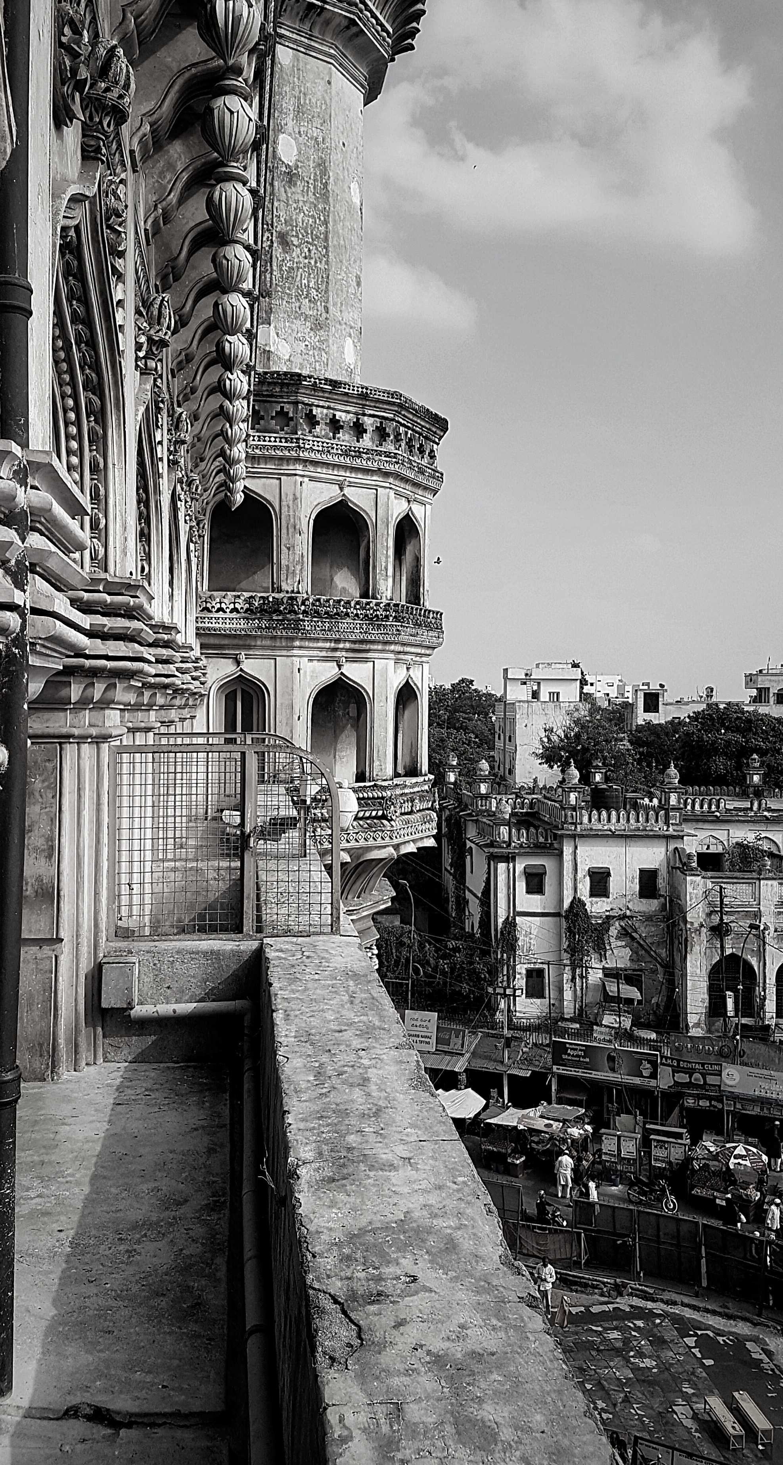
The Presentation Guide
TOPICS TO BE COVERED
Introduction Business Problem Data Methodology Results Discussion Conclusion

Slide 4

INTRODUCTION
Hyderabad is one of the oldest cities, highly known for the variety of spices and ranked city in spices and is the IT Hub of
India
City of Telangana, India is known for its availability of various
cuisines, hotels
Hyderabad is was ruled by the Qutub Shahis, Mughals and the Nizams which shaped its history. The city is noted for its
monuments

Slide 5


Business Problem
Helping the investor find a better place to open restaurant
Neighbourhood that is most likely to give a good business Finding intrests of people across the city

Slide 6

Data
Neighbourhoods of Hyderabad
– Neighbourhoods of Hyderabad wikipedia page
through data scraping.
Geographical coordinates of the
neighbourhoods
– Using GeoPy library.
Venue data from FourSquare

Slide 7
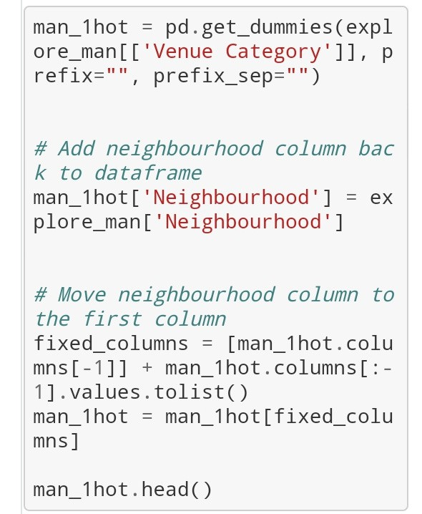
Methodology
FEATURE EXTRACTION
One Hot Encoding

Slide 8
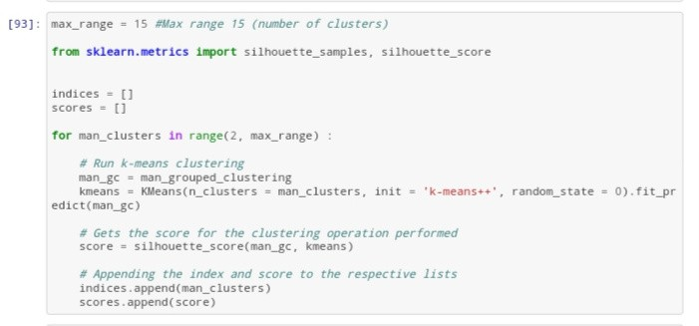
Unsupervised Learning
K- means clustering

Slide 9


Discussion
Most suitable neighbourhoods for starting the restaurant
business are present in the cluster number 2, 3
Our K-Means model worked perfectly and successfully clustered similar neighbourhoods together.
After studying all three clusters, it is recommended to the
client that neighbourhoods such as HITECH CITY, RAJBHAVAN ROAD, BANJARA HILLS that fall in cluster 2, 3
look like good locations for starting their restaurant business.
The client can go ahead and make a decision depending on other factors like availability and legal requirements that
are out of scope of this proj

Slide 10

CONCLUSION
Data analysis and machine learning techniques
used in this project can be very helpful in
determining solutions of certain business
problems.
Python’s inbuilt libraries such as GeoPy, Folium
and BeautifulSoup make it very easy and effective
to analyse a geographical location.
In this project we studied the neighbourhoods of
Hyderabad city and came up with a

